Slide 1
Knock-in mouse model, App^{NLF/NLF}, with slow plaque development into old age, shows plaque specific gene expression pattern more similar to that found in post-mortem tissues from people with Alzheimer’s disease. Aya Balbaa Edwards lab, Department of Neuroscience, physiology and pharmacology UCL

Slide 2
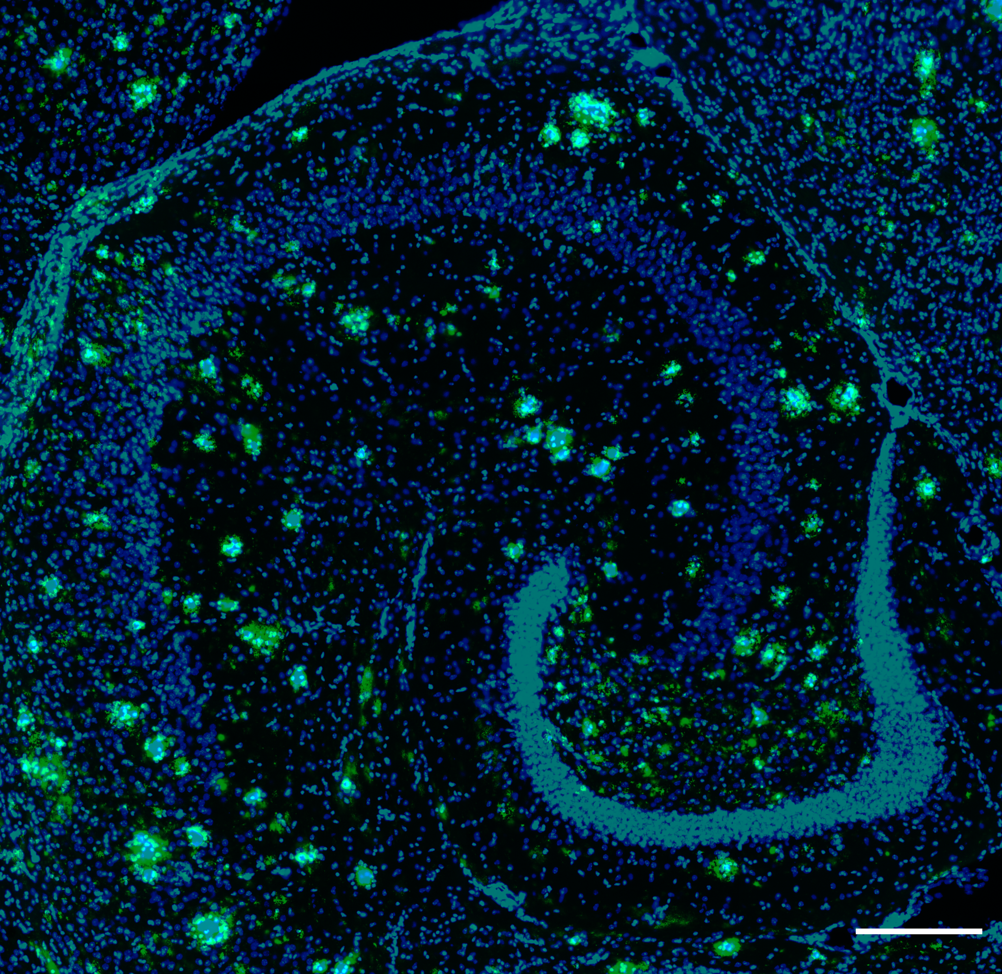
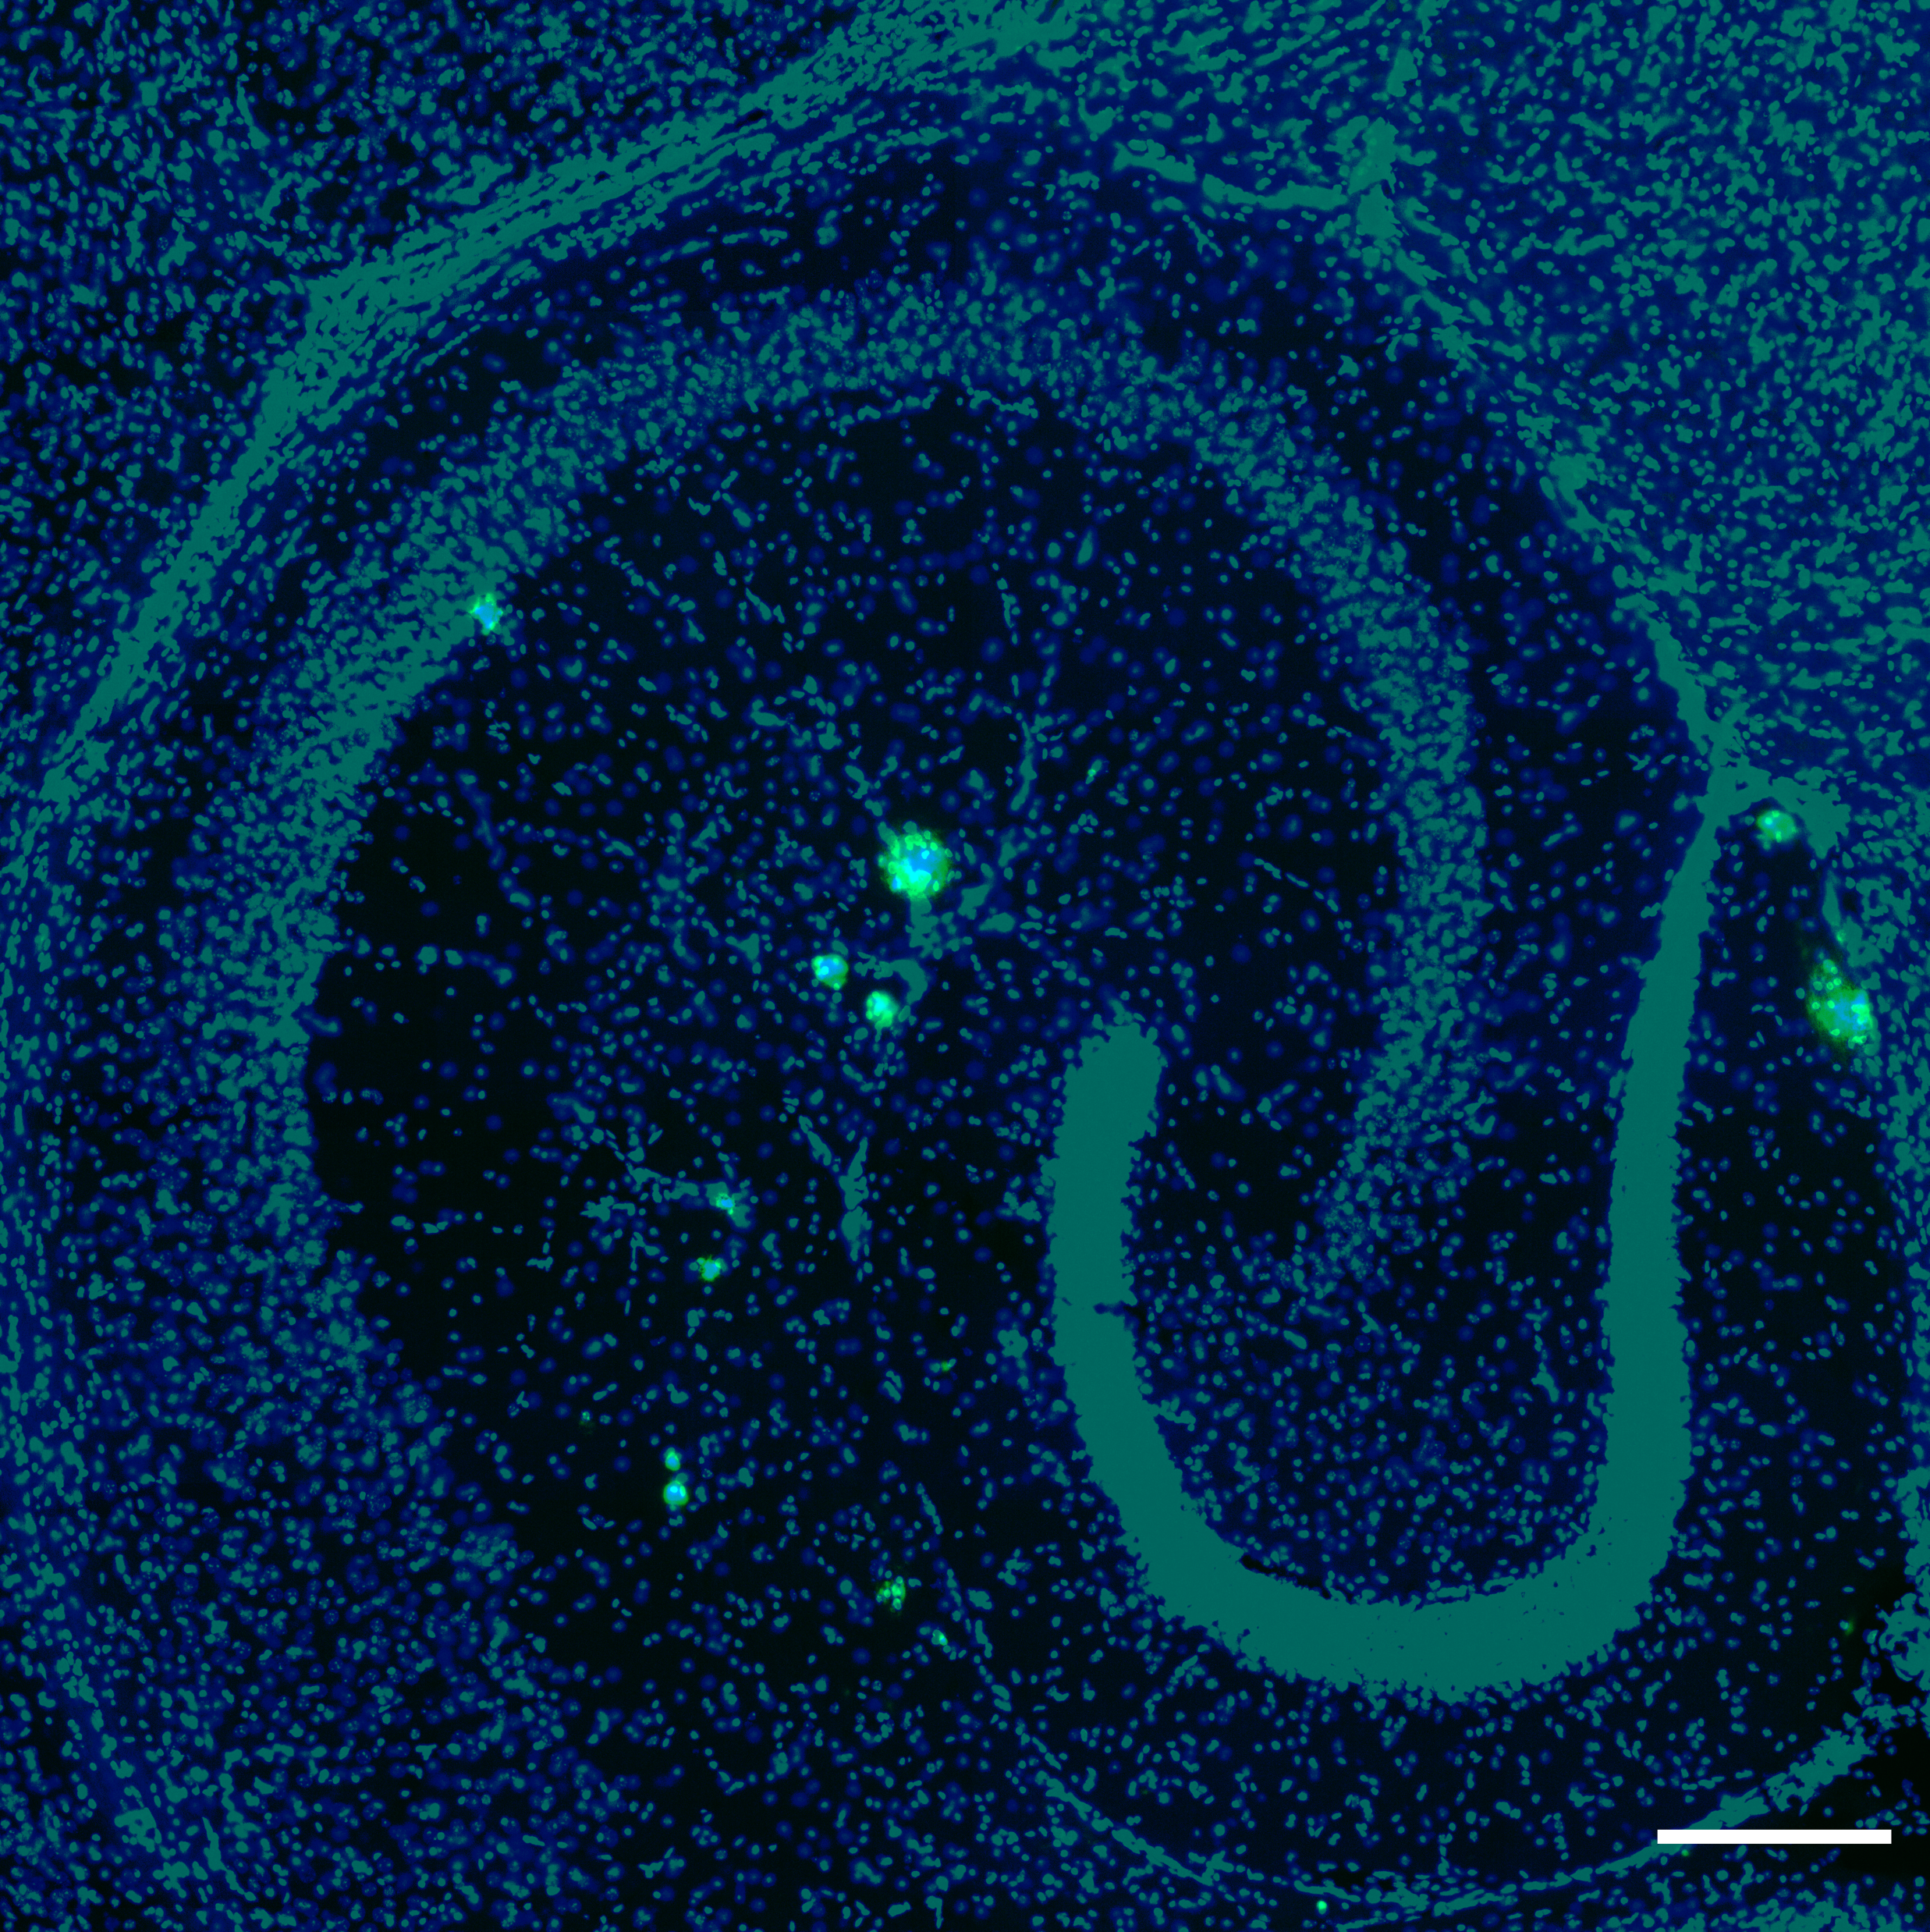

Introduction:
NLGF
NLF
APP^{NLGF/NLGF} 18 months
APP^{NLF/NLF} 18 months
Early onset and fast progression
Late onset and slow progression
Saito et al, 2014

Slide 3
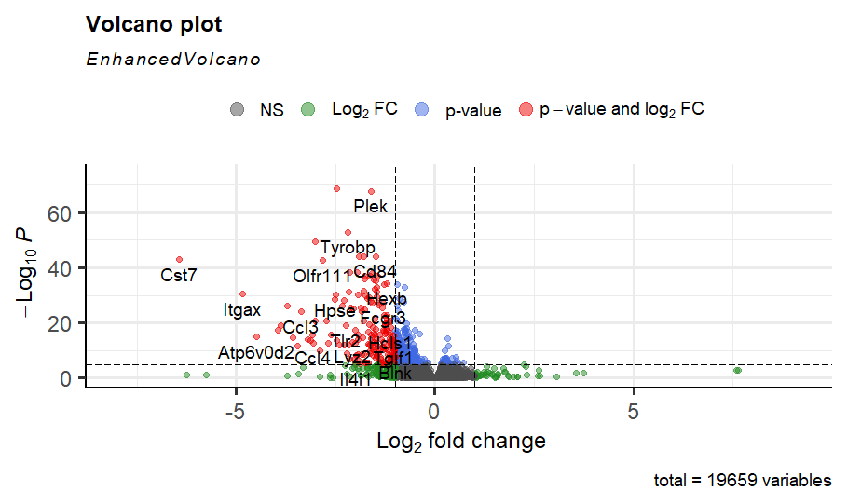
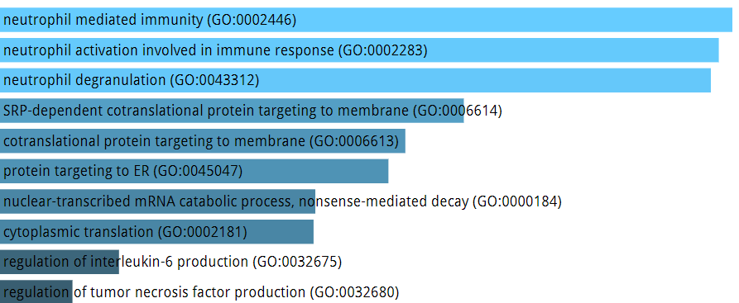
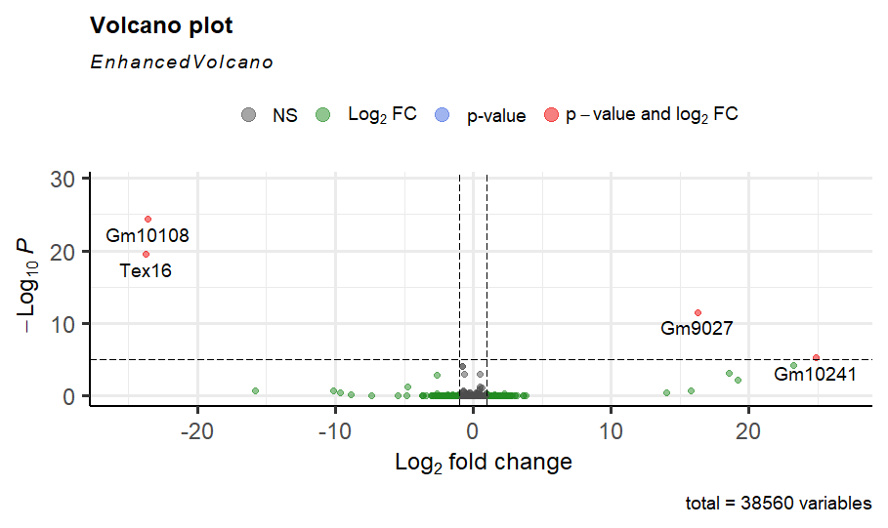




Methods:
Whole hippocampal RNA was extracted from WT, NLF and NLGF mice (n=9-12/genotype; mixed sex; 18 months old). Differential expression analysis was done to compare WT to NLF or NLGF using DESeq2 R package.
WT vs NLGF
Gene name
Tex16
Ibtk
Btaf1
Ide
Gm10108
Cst7
WT vs NLF

Slide 4
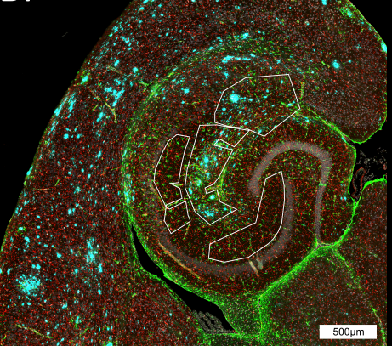
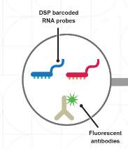
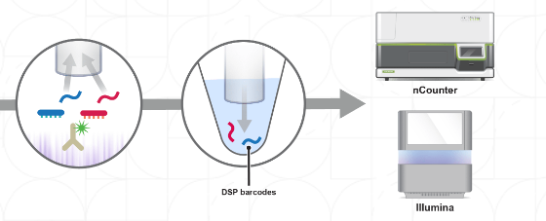

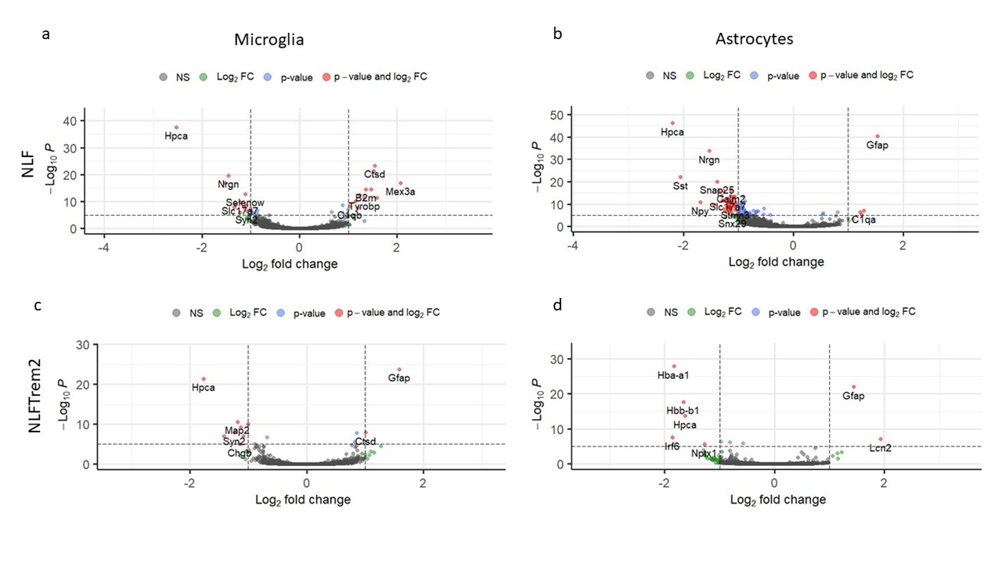

Spatial transcriptomics in NLF mice:
Plaque
Away

Slide 5
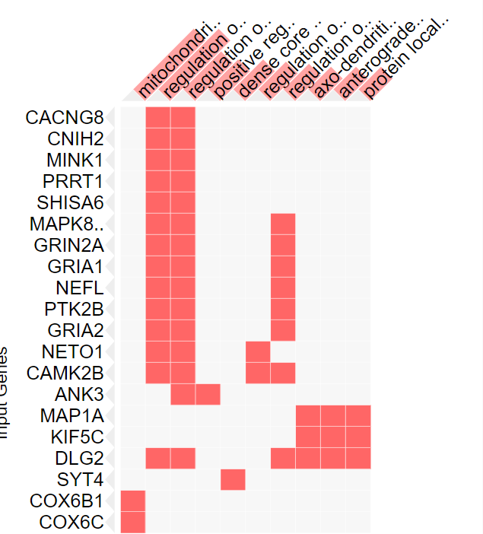

Results:
Human hippocampal microarray DEGs
NLGF exclusive
set
NLF-plaque exclusive genes
WT vs NLGF
2173
52
278
NLF exclusive
set
2235
175
381
P=0.334
359
22
308
Most importantly is that these genes were found in post-mortem AD studies and 22 genes significantly overlapping with genes changing in hippocampi of post-mortem AD 10.3389/fnagi.2018.00153 . While those from NLGF, the overlap is not significant
P=1.45e-05

Slide 6

Conclusion:
Thus, this model mimics the phenotype of human AD in the late onset.
In this project we found that NLF has similar hippocampal gene expression changes to human hippocampus.
Fast rising plaques can have different effects from slow rising plaques in old age.
Results from NLF may better translate to the human condition.
Recent advances in transcriptomics allow the study of more subtle phenotypes

Slide 7
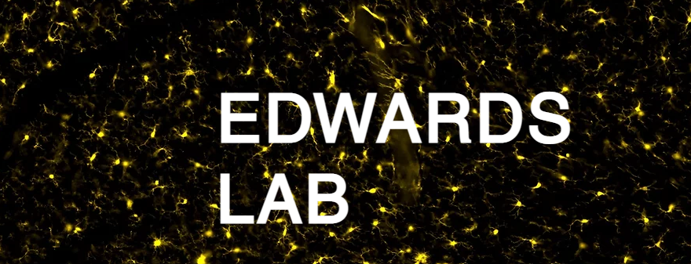

Aya Balbaa Jack I. Wood Aishwarya Pathak Eugenia Wong Ridwaan Joghee Sneha Desai Damian M.Cummings Takshashila Tripathi John Hardy Frances A.Edwards¹.

